Slide 1
TO DO Application
Szymon Rećko, Hubert Ruczyński, Mateusz Sperkowski
01.06.2023

Slide 2
About the APP
TO DO App is an online website hosted on the AWS servers that enables the user to create and log in to their own accounts, and create their workspace with easy to manage TO DO list. Additionally, the user can easily filter the tasks by their completion state or the due date.

Slide 3
Functional requirements
RETRIEVAL OF ACCOMPLISHED TASKS
Allow users to retrieve all the tasks in their to-do list.
CUSTOMIZABLE TASKS CREATION
Allow users to create a new task in their to-do list with a title, description, status, and due date.
POSSIBLE UPDATES
Allow users to update an existing task's title, description, status, and due date.
MONITORING TASKS STATES
Allow users to mark a task as TO DO, in progress, or completed, and remove it from the to-do list.
TASKS FILTERING
Provide an option for users to filter tasks by their status (in progress, completed, or incomplete) and due date.
Registration and login
Allow users to create their personal accounts and safely log in to the system.

Slide 4
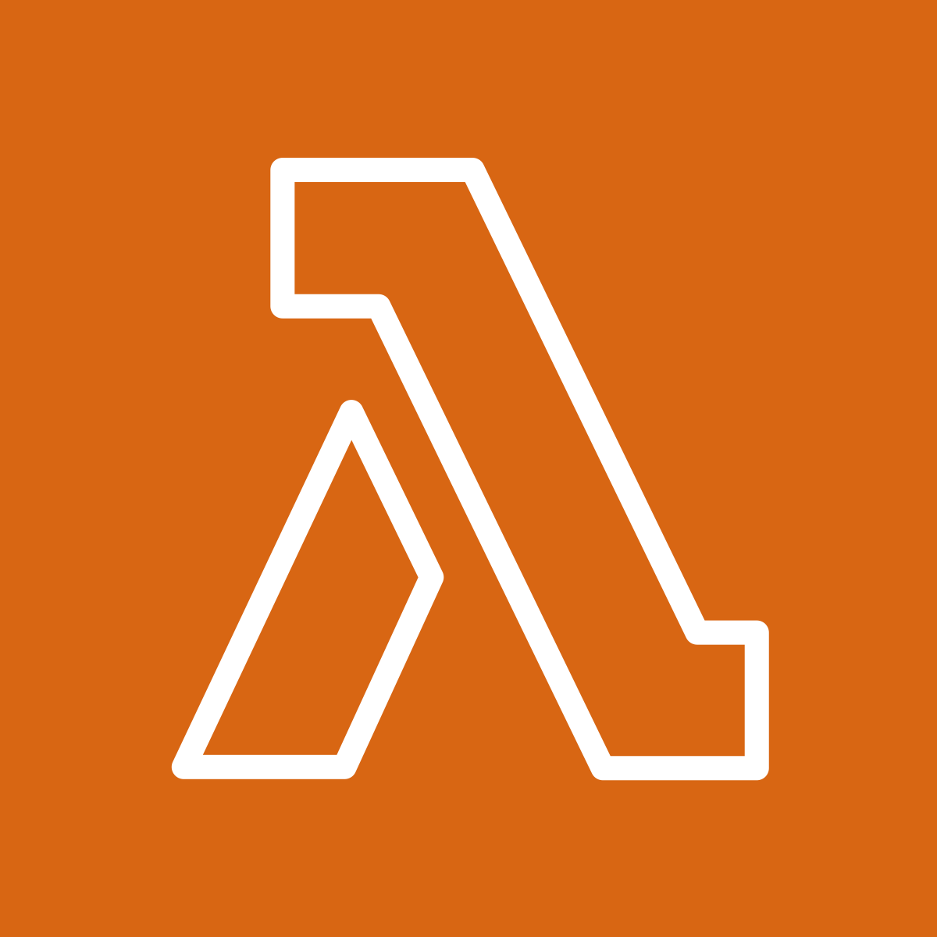
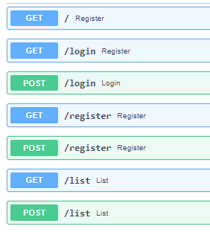
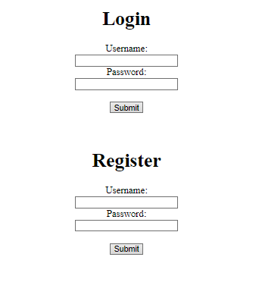
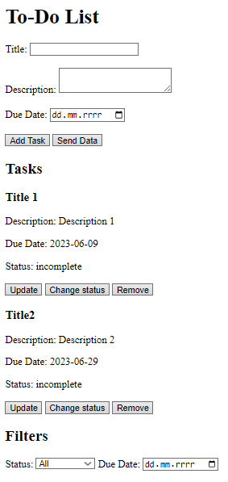

Serverless Lambda App
Back-end in Python FastAPI
"Front-end" in JavaScript and HTML
Database connection using psycopg2
Password hashing using bcrypt.
Cookie-based authentication.
Magnum - adapter for running FastAPI applications in Lambda
Lambda stores database access parameters in environment variables

Slide 5
Non-Functional requirements
SCALABILITY
Handle an increase in traffic without any performance degradation.
RELIABILITY
Provide a consistent level of service even in the face of hardware or software failures.
SECURITY
Protect against unauthorized access and data breaches.
PERFORMANCE
Low response times available.
COST OPTIMIZATION
Minimize infrastructure costs while still meeting the application's needs.

Slide 6
Non-FUNCTIONAL requirements assurance
SCALABILITY
RELIABILITY
Scalable DB instances from 100GiB to 1000GiB.
The Lambda scales up to 400 concurrent workers.
Multi-AZ deployment with a Database standby copy in different AZs
The Lambda is available in 2 Azs which makes it resilient to failovers.
SECURITY
PERFORMANCE
Database secured with login and password, available only from instances in the same VPC, and deployed in the private subnet.
Hashed account passwords.
Extremely lightweight implementation with API calls.
Only aggregated read/write operations to and from the database.
COST OPTIMIZATION
The use of cheap db.t4g.micro instances.
Lack of extensional expenses (ex. 2nd Region).
Lack of redundant features (ex. RDS proxy).

Slide 7
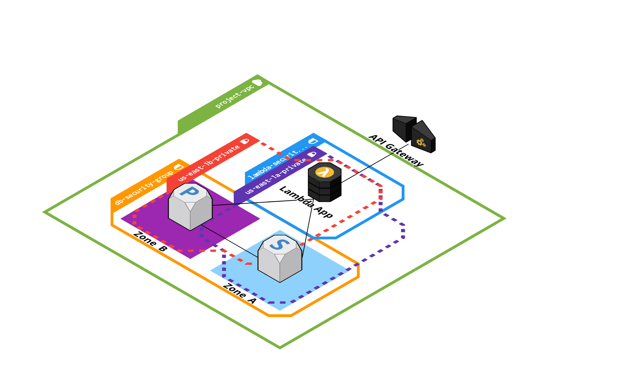
Project diagram

Slide 8
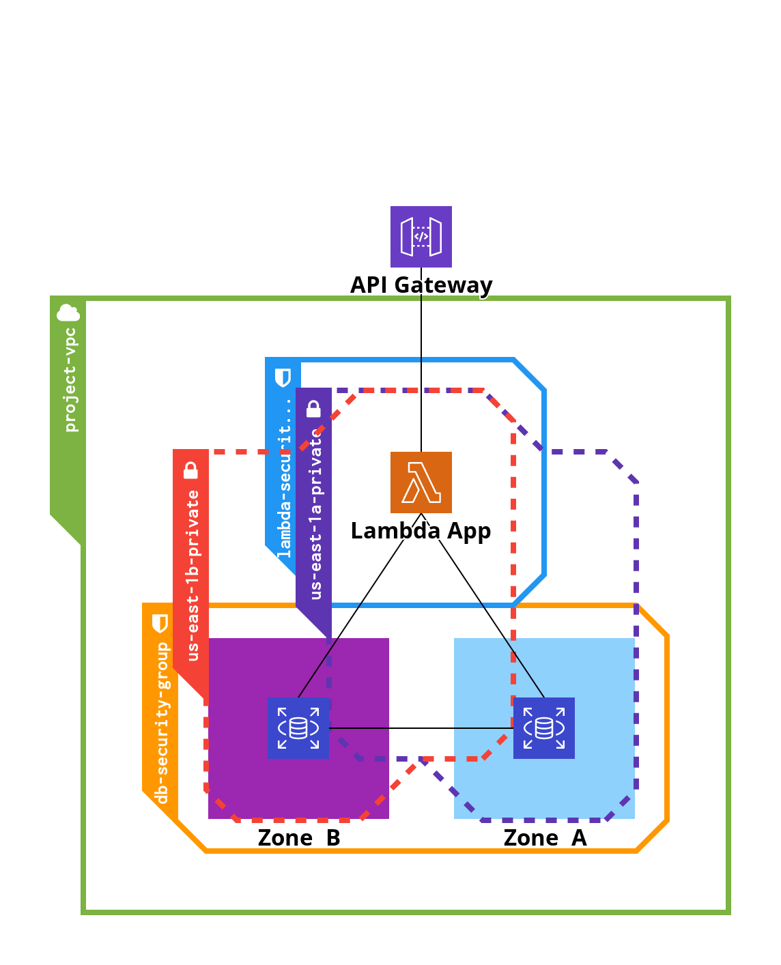
Project diagram

Slide 9
Cost estimation
6.21$ / 0.80$ Per MO
17.50$
PER mo
52.56$
PER MO
Lambda
API Gateway
RDS
App execution.
Estimated 5 million requests per month.
Connection with the Application.
Estimated 5 million requests per month.
Primary PostgreSQL Database and its Standby in different Availability Zone.

Slide 10
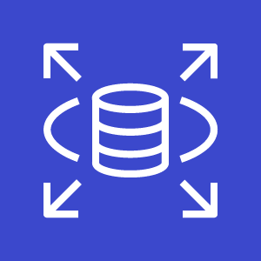
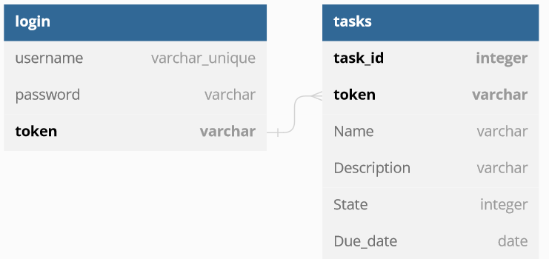
Database – Postgres sql
Security
SQL injection protection,
Available only from AWS VPC, with no public access,
Database security group managing the access,
Master admin account,
Deletion protection,
Hashed passwords using bcrypt.

Slide 11
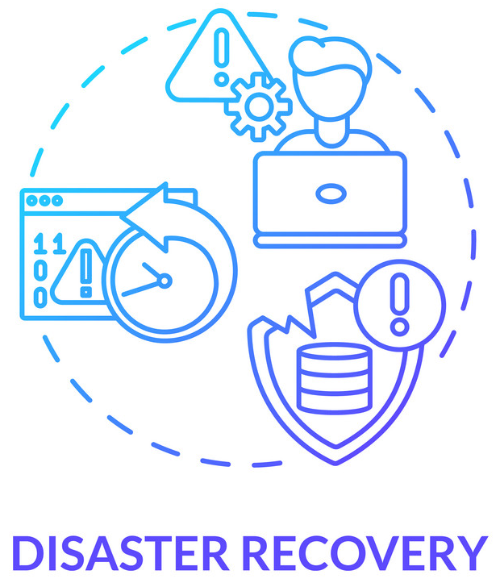
Backup & Disaster Recovery
DB Multi-Az deployment
With the Multi-AZ deployment, we can ensure that the users won’t lose their data, as the standby DB will be always available in separate availability zone.
Automatic switch
Thanks to the Multi-AZ technology, when the failover happens the application will automatically change to the standby instance with the current data.
rto
According to the AWS documentation, the mean time between switching to the standby instance takes up to 1 minute.

Slide 12
Technical tips & tricks
PostgreSQL DB creation
Lambda App
During the early development select one AZ, and no backup to limit the costs, it’s easily applicable later on.
During the development make it public, so you can easily connect from pgAdmin.
Don’t use the RDS proxy, it enhances the costs greatly for every instance.
Develop the app using VPCs Endpoint Gateway, so the AWS services are easily accessible.
Firstly, develop the app, and later manage the cloud, you can see if you break something.
Create one Lambda with multiple endpoints for small applications, it’s less work while adding new features.
Cloudcraft diagrams
It’s a useful tool to use during the planning phase.
Greatly helps with the cost estimation.
Reminds about placing the services inside VPC, subnets, and so on.

Slide 13
Summary
Cloud architecture is very beneficial for medium and large-size applications, as it easily enables upscaling and doesn’t bring any upfront costs, however, even the smallest machines like databases or EC2s are extremely costly, thus making small apps more pricey than they should be.

Slide 14
Thanks for attention

